Slide 1
MATH
Machine Learning
LAB 2
Bharuno Mahesworo

Slide 2
How to LAB?
Download this PPT
Follow the instruction
Screen shoot your code and its result of each instruction, then put it on the instruction slide.
Submit your slide deck and notebook file
Googling is permitted
Using Communication platform (email, discord, social media, etc.) is prohibited
Submit to:
bharuno.mahesworo@binus.ac.id
Before the end of the LAB.
Subject: ML_(class code)_(LAB session)_NIM
Example: ML_LZ99_LABn_12345
File name format: ML_(class code)_(LAB session)_NIM
Example: ML_LZ99_LABn_12345

Slide 3
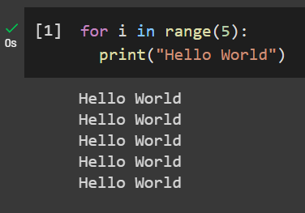
Print Hello World 5 times using loops
Example
Instruction
Your compiled codes
hint
for loops or while loops

Slide 4
LAB 2 – Regression Health Data
The objective of the dataset is to diagnostically predict ‘y’ of the patients based on their physical condition. “dataset_lab2.csv” can be downloaded from binusmaya
Target Variable
y: numeric
Features
id – id patient
age
sex
fracture – bone fracture or not
weight_kg
height_cm
medication – medication consumed
waiting_time

Slide 5
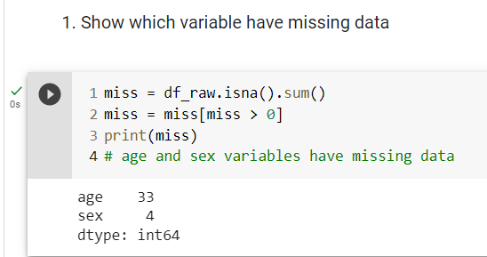
1. Show which variable have missing data

Slide 6
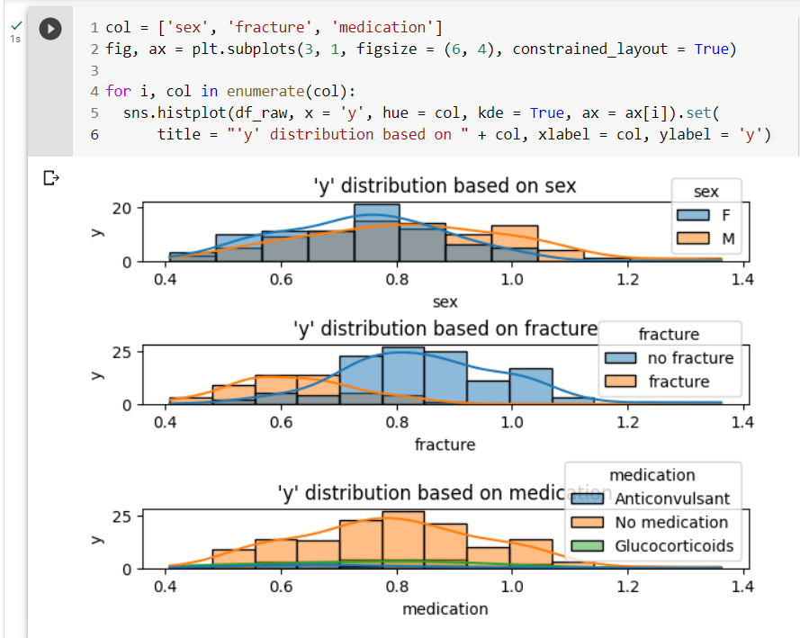
2. show ‘y’ distribution on each gender, fracture/no fracture, and each medication consumed. Give proper chart title and axis labels.

Slide 7
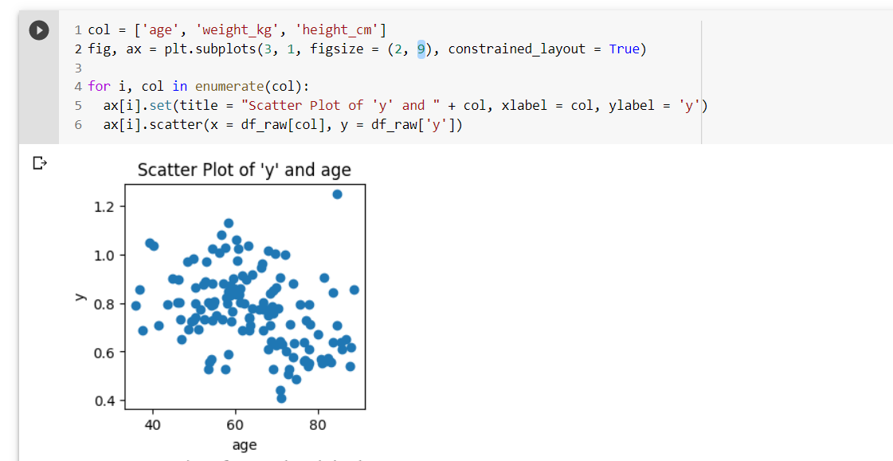
3. show ‘y’ relationship on age, weight, and height. Give proper chart title and axis labels.
scatter

Slide 8
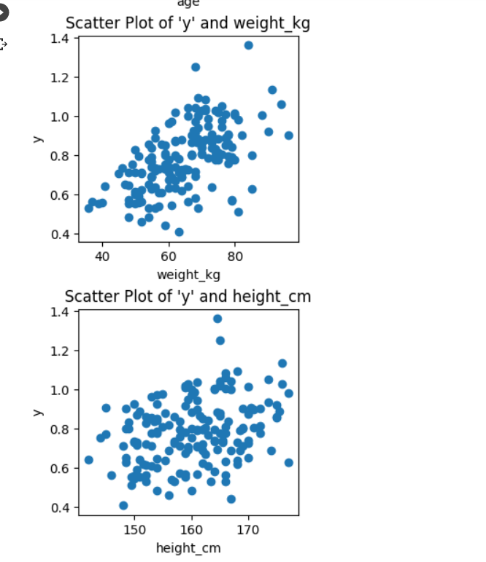
3. show ‘y’ relationship on age, weight, and height. Give proper chart title and axis labels.
scatter

Slide 9
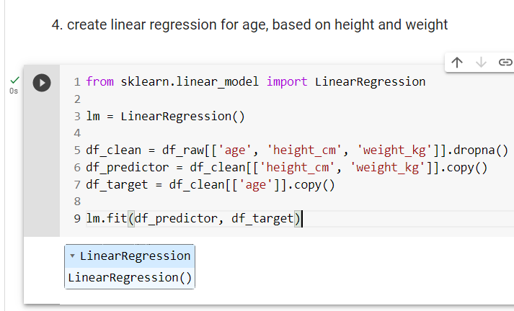
4. create linear regression for age, based on height and weight

Slide 10
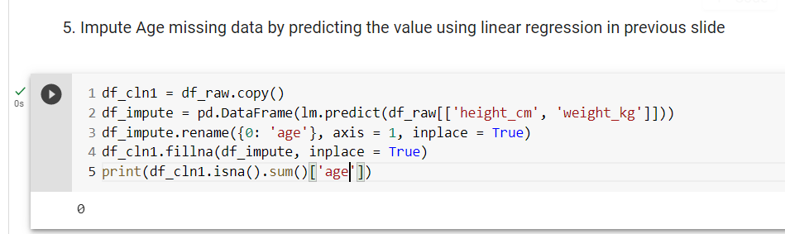
5. Impute Age missing data by predicting the value using linear regression in previous slide

Slide 11
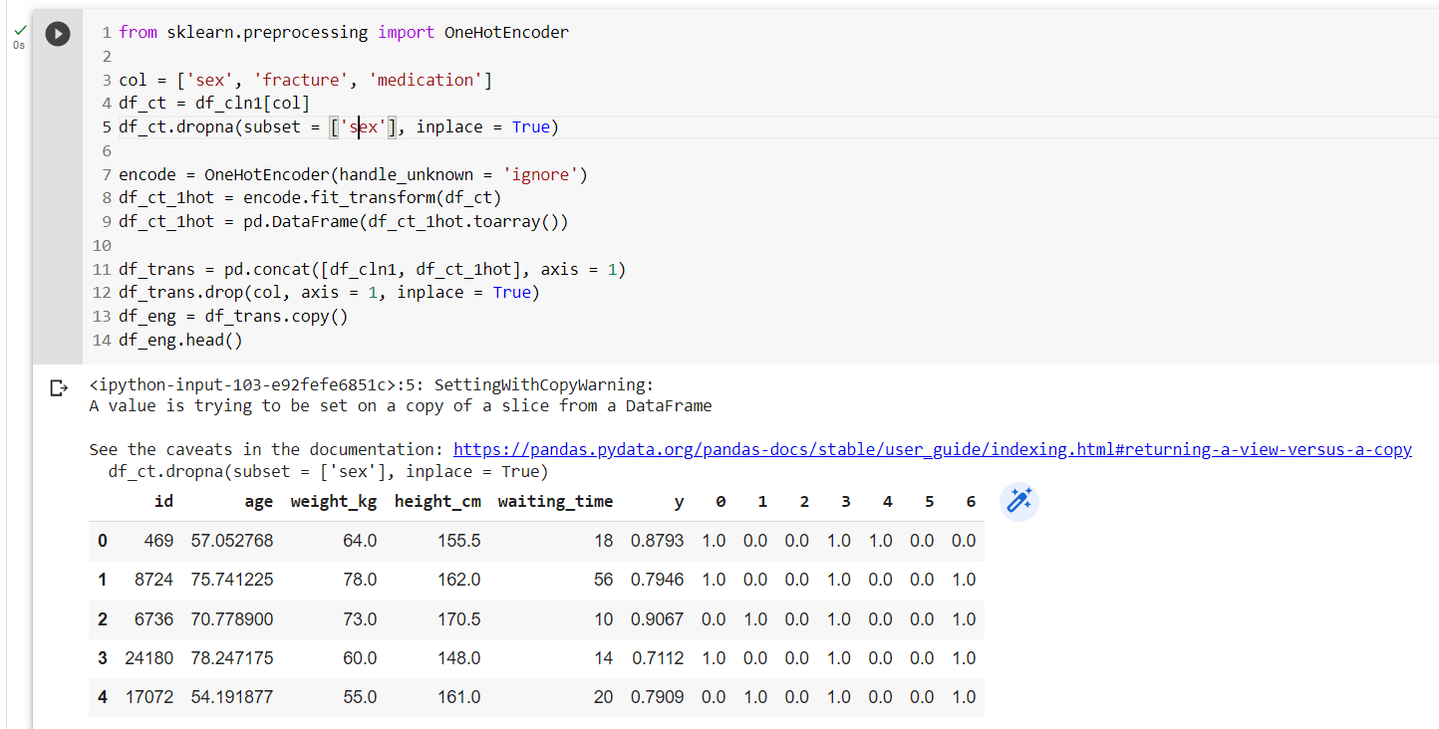
6. Feature engineering categorial variable into on hot encoding

Slide 12
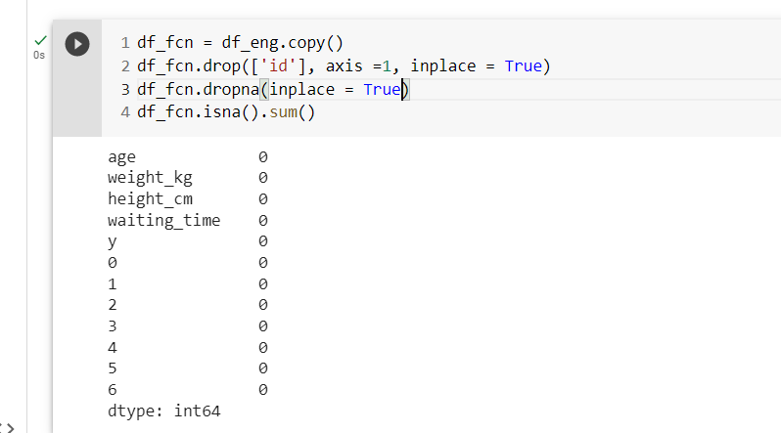
7. Drop Rows that still have null value and drop unnecessary columns

Slide 13
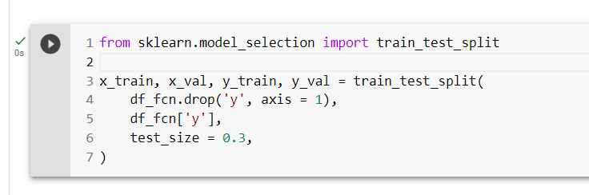
8. Separate the predictors from the target variable and split the dataset into training and validation sets
train_test_split()

Slide 14
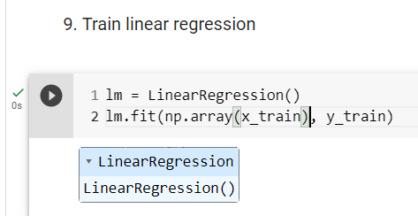
9. Train linear regression
LogisticRegression()

Slide 15
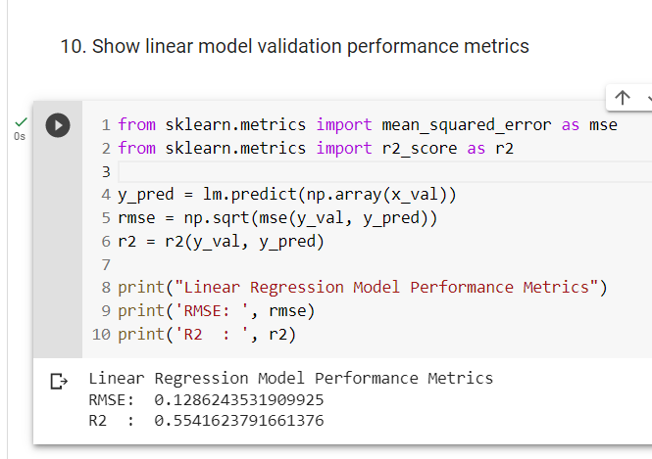
10. Show linear model validation performance metrics
RMSE, R2

Slide 16
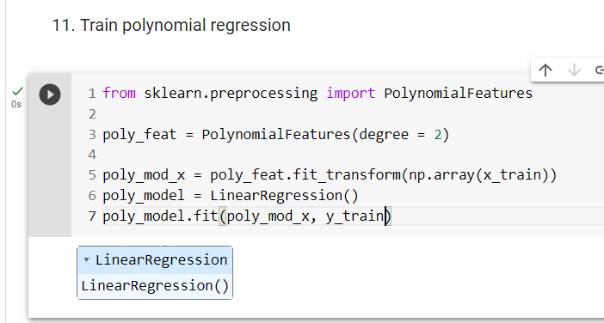
11. Train polynomial regression
PolynomialFeatures

Slide 17
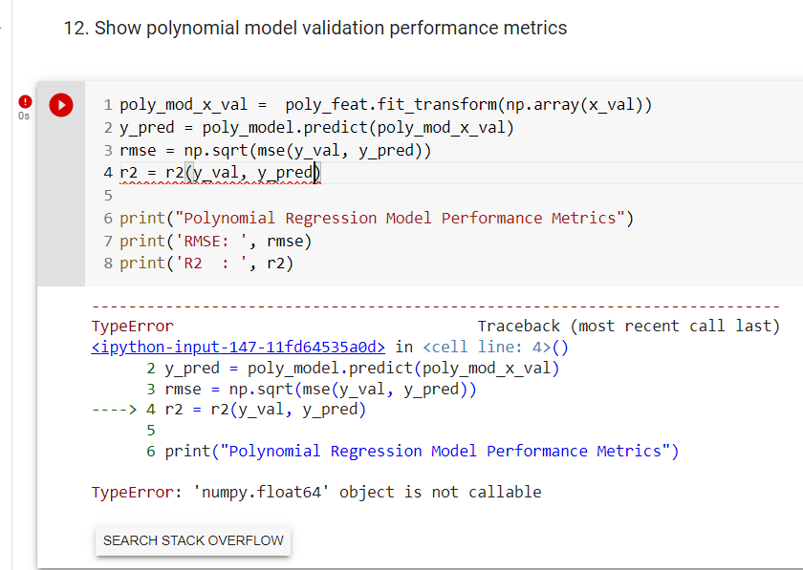
12. Show polynomial model validation performance metrics
RMSE, R2

